Slide 1
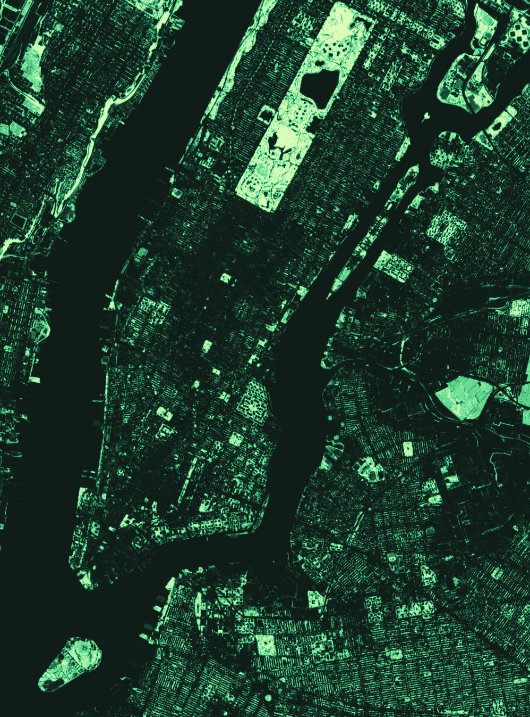
Green
Diff
FINAL PROJECT PROPOSAL
Watching New York’s green space change from space, and only looking at what changed.
[Your name] · Intro to ML for the Arts
Notes:
My project is called Green Diff. I use satellite images to see how New York’s green space changes every year. And I try to do it the lazy way: only look at the parts that changed.

Slide 2
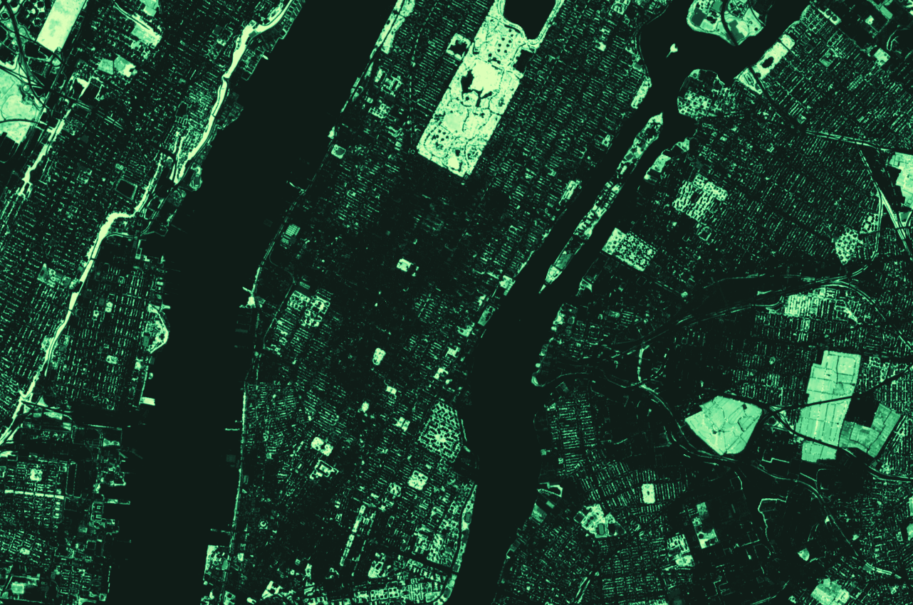
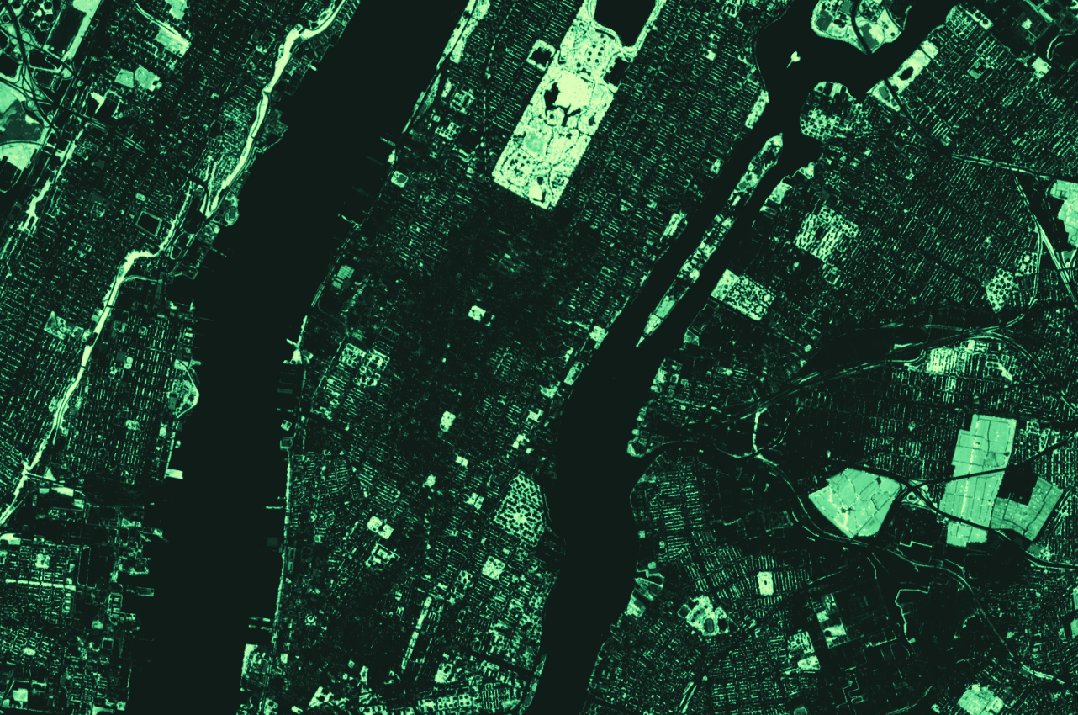
Spot the difference
Summer 2018
Summer 2026
Same place, eight summers apart. Brighter means more plants. Images: Sentinel-2.
Notes:
You know those “spot the difference” puzzles? Two pictures that look the same, and you have to find five small changes. Nobody solves those by studying every corner of both pictures. Your eyes skip the parts that match and jump to the parts that don’t. A city from space is the same puzzle. These are two summers, eight years apart. Almost everything is the same. The buildings didn’t move. The rivers didn’t move. But somewhere, a park opened, or a lot got paved.

Slide 3
WHAT I’M MAKING
I use free satellite images to measure how NYC’s green space changed each year, and I only run the slow AI model on the parts that actually changed.
QUESTION 1
QUESTION 2
Where is the city gaining or losing green?
How much work can I skip by only looking at what changed, and what do I miss?
Notes:
One sentence: I use free satellite images to measure how NYC’s green space changed each year, and I only run the slow AI model on the small parts of the city that actually changed. So there are two questions. First, where is the city gaining or losing green? Second, how much work can I skip by only looking at what changed, and what do I miss when I skip?

Slide 4
How a satellite sees plants
Central Park
Free pictures, 10 m pixels
Sentinel-2 photographs the city every few days. Each pixel is 10 m wide.
Light we can’t see
Plants soak up red light and bounce near-infrared light away. To this camera, healthy plants glow.
NDVI = (infrared − red) ÷ (infrared + red)
High means plants. Low means water, roads and roofs.
Notes:
The satellite is called Sentinel-2. The images are free. Each pixel is 10 meters wide. It sees a kind of light we can’t see, called near-infrared. Plants soak up red light to make food, and they bounce near-infrared light away. So to this camera, healthy plants glow. There’s a simple formula that compares those two kinds of light. It’s called NDVI. High number means plants. Low number means water, roads, and roofs. This is my demo running on real data. Nine summers, 2018 to 2026, 36 images. You can see Central Park right there.

Slide 5
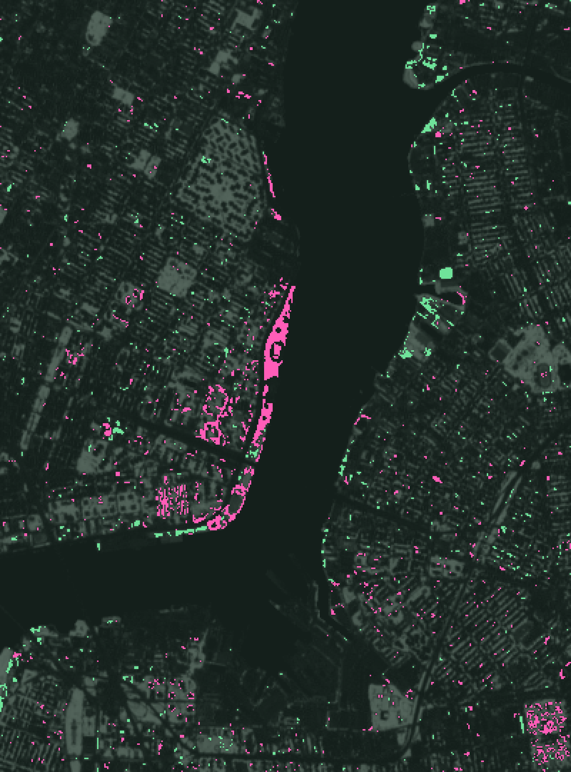
A story the satellite found
Green = gained
Pink = lost
This pink strip is East River Park. Starting in late 2021, the city tore up large parts of it to raise the land against flooding.
East River Park
How green that spot was each summer: steady through 2021, then falling
2018
2019
2020
2021
2022
2023
2024
2025
2026
Notes:
Green means gained. Pink means lost. Look at this pink strip on the Lower East Side. I didn’t tell the program to look there. It found it. That’s East River Park. Starting in late 2021, the city tore up big parts of it to raise the land and protect the neighborhood from flooding. In my data, the green there stays steady through 2021 and then drops year after year. So one pink strip is also a story about a neighborhood trading trees today for flood protection later. Note to self: the park was matched from map coordinates and timing. Check it on a map before presenting. The bars are the average NDVI of one 320 m tile: 0.23, 0.23, 0.19, 0.22, 0.17, 0.14, 0.17, 0.11, 0.01.

Slide 6
Is the lazy way worth it?
0.5%
Tiles I must check to catch 90% of the change
640 m tiles
47%
320 m tiles
30%
of pixels change from one summer to the next
160 m tiles
15%
80 m tiles
7%
Smaller tiles, bigger savings.
Demo: 36 Sentinel-2 images, summers 2018 to 2026. Greenness formula only. No slow model tested yet.
Notes:
Now the optimization. I cut the map into tiles and counted the change in each one. In one year, only about half a percent of the pixels change. So my guess was right: most of the image is the same. But the change is sprinkled around. With big tiles, 320 meters wide, I’d still have to check 30% of them to find 90% of the change. With small tiles, 80 meters wide, I only need 7%. So the idea works, and the tile size matters a lot. If asked: these numbers rank the tiles using the true amount of change. A real gate only gets a cheap guess, and I haven’t tested that yet. An 80 m tile is also only 8 by 8 pixels, which may be too small for a neural network.

Slide 7
What’s next
Compare real models on the tiles that changed
Done
Week 1
Week 2
Week 2
Week 2
NDVI
Random forest
Small CNN
Dynamic World
Gemini
A formula. No learning.
Many small decision trees that vote.
Like Doodle Invaders, but it labels every pixel.
Google’s ready-made land cover model.
Sees before and after. Answers in words.
WHY SKIPPING MATTERS
THE FINAL PIECE
In my text adventure, a picture cost 8× more than text, so I only redrew a room when it changed. Same trick, bigger map.
A web page where you slide through the years and click the places that changed.
Notes:
Right now my “model” is just a formula. Next I’ll compare real models: a random forest, a small CNN like the one from our CNN week, Google’s land cover model, and Gemini looking at before and after pictures. Those are slow. That’s where skipping tiles really pays off. In my text adventure, a picture cost 8 times more than text, so I only redrew a room when it changed. This is the same trick for a whole city. For the final, I want a web page where you slide through the years and click the places that changed.

Slide 8
Who it’s for, and what’s hard
For people who live here
What’s hard
Find your own block and see what happened to it.
Clouds, shadows and a dry August all look like change.
A 10 m pixel is too big to see one street tree.
I still need a slow model that’s worth skipping.
What place in New York would you check first?
Notes:
This is for people who live here. I want you to find your own block and see what happened to it. My biggest challenge is that pixels change even when the city doesn’t. Clouds, shadows, and a dry August all look like change. And 10 meter pixels are too big to see one street tree. My question for you: what place in New York would you want to check first?

